Slide 1
Happy Holidays!
David, Tabitha, Ewen, and Fiona

Slide 2
Happy Holidays!
Merry Maxmas!
David, Tabitha, Ewen, Fiona, and Max

Slide 3
2022

Slide 4
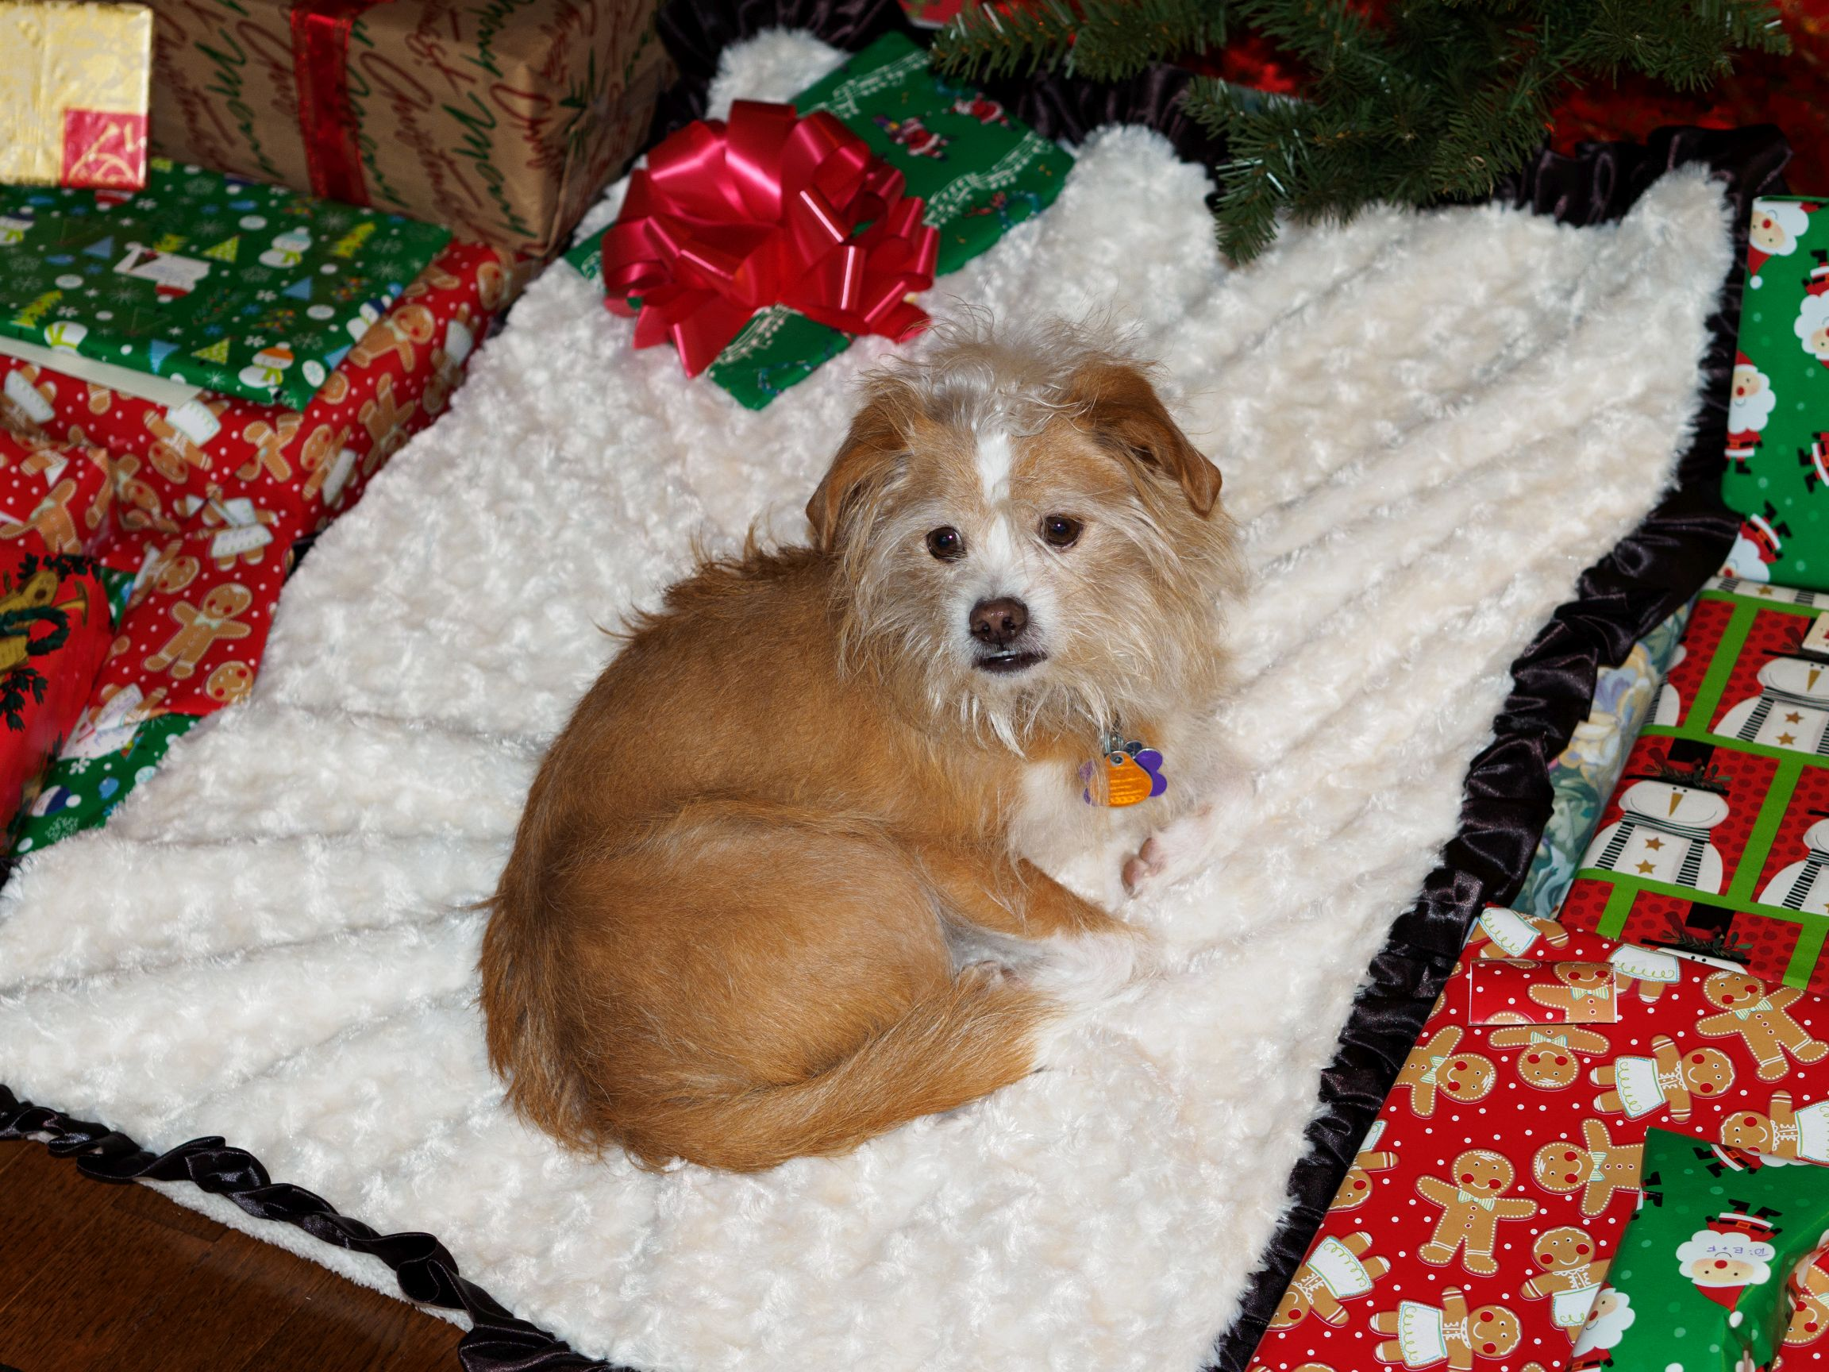
In Loving Memory
Of MAD MAX
2006? - 2022

